Slide 1
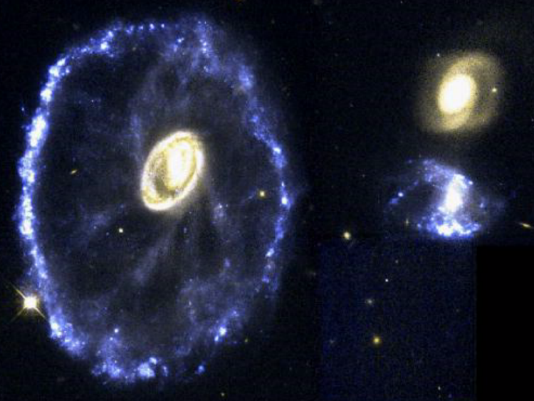
Lake Afton Public Observatory
Computer Exhibit
Click here to begin

Slide 2
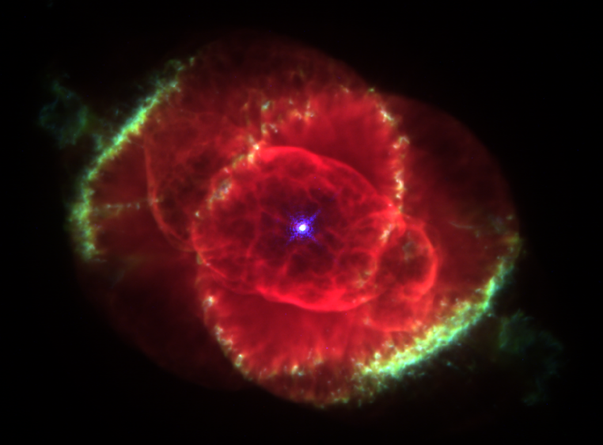
Lake Afton Public Observatory
Computer Exhibit
Click here to begin

Slide 3
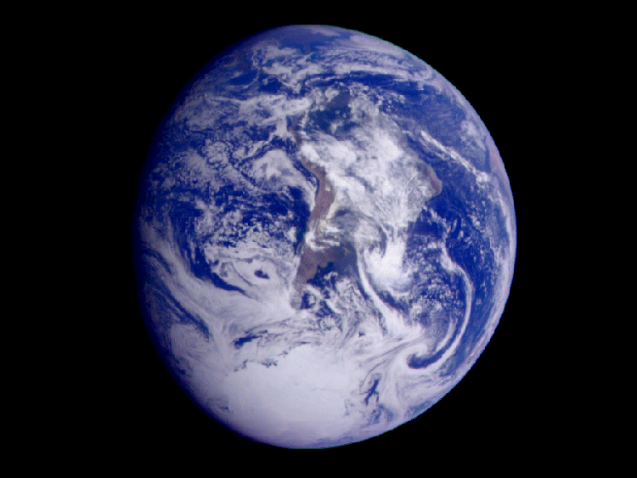
Lake Afton Public Observatory
Computer Exhibit
Click here to begin

Slide 4
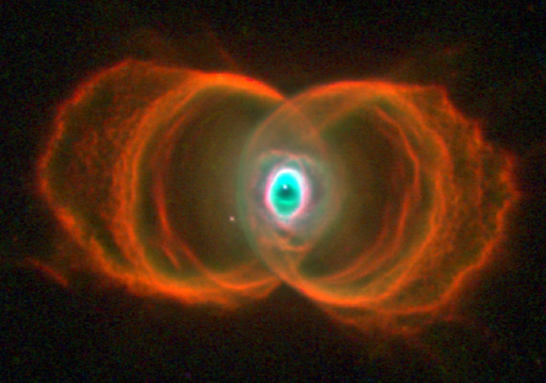
Lake Afton Public Observatory
Computer Exhibit
Click here to begin

Slide 5
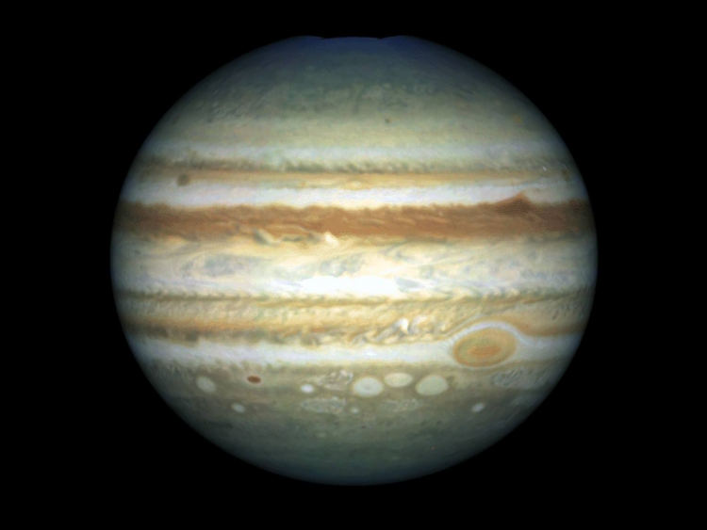
Lake Afton Public Observatory
Computer Exhibit
Click here to begin

Slide 6
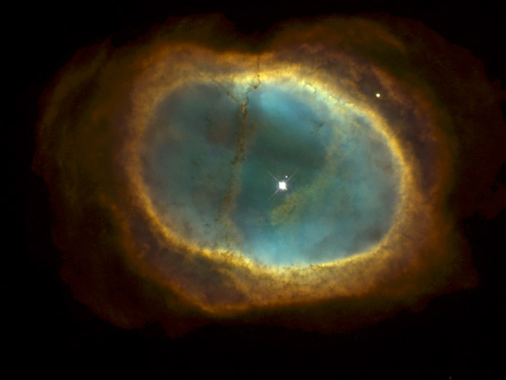
Lake Afton Public Observatory
Computer Exhibit
Click here to begin

Slide 7
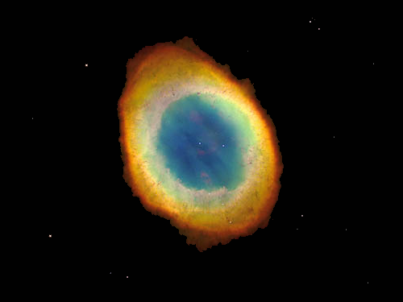
Lake Afton Public Observatory
Computer Exhibit
Click here to begin

Slide 8
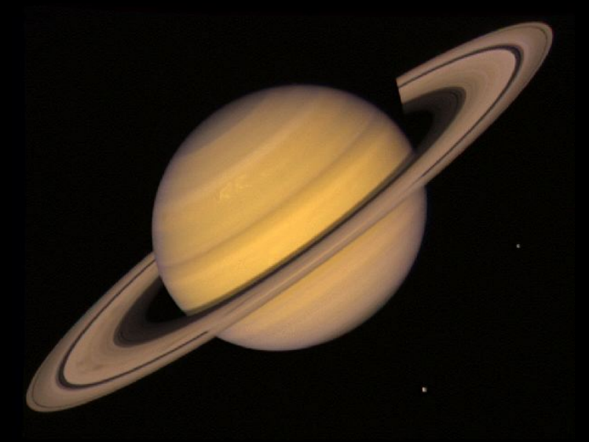
Lake Afton Public Observatory
Computer Exhibit
Click here to begin

Slide 9
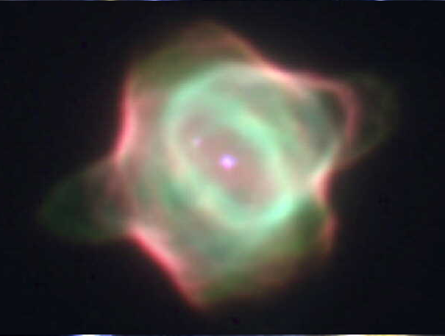
Lake Afton Public Observatory
Computer Exhibit
Click here to begin

Slide 10
Lake Afton Public Observatory
Computer Exhibit
Astronomy Computer Games
Alphabet Game: Click on a letter and a picture is displayed. (Designed for younger players)
The Discoveries of Spirit and Opportunity
Cassini and Huygens at Saturn
Current Program Presentation
(These are the slides you saw in the Observing Room)
Click on the button next to your selection

Slide 11
Lake Afton Public Observatory
Computer Games
Constellations: See if you can identify some of the more familiar constellations.
Planet Trek: Go on a scavenger hunt through the solar system.
Space Pirate: Find the bomb Derth Vader planted on your ship before it’s too late.
Trivia: Test your knowledge of astronomy.
Return to the Main Menu

Slide 12
Lake Afton Public Observatory
Lunar Lander
Computer Game
Lunar Lander I: The computer will help you land on the moon
Lunar Lander II: You are on your own -- although if you start getting in trouble, the computer will warn you.
Return to the computer game menu.
Return to the main menu.

Slide 13
Lake Afton Public Observatory
Computer Exhibit
Astronomy Computer Games
Alphabet Game: Click on a letter and a picture is displayed. (Designed for younger players)
Visions of the Universe: Learn more about some of the objects found in space
The Discoveries of Spirit and Opportunity
Click on the button next to your selection

